Slide 1
The Electromagnetic Spectrum

Slide 2
By the end of this Smart Lesson, you should be able to:
1. | Explain what the electromagnetic spectrum is.
2. | Identify the properties of the seven forms of EMR.

Slide 3
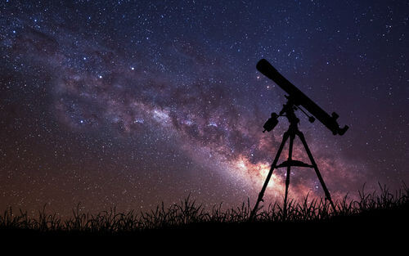
Electromagnetic radiation, or EMR, is travelling energy that displays properties of both waves and particles.
Scientists have to classify EMR as both a wave and a particle because it acts differently depending on the situation. This explains how EMR can travel through space when other waves cannot!

Slide 4

EMR exists on a spectrum; the spectrum includes seven different types of EMR, all of which vary in wavelength, energy and frequency.
Light falls in the middle of the EMR spectrum and includes all the wavelengths that we can see.

Slide 5
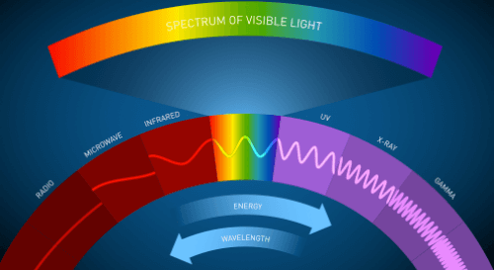
Visible light is the most well known form of EMR.
Other forms of EMR include radio waves, microwaves, infrared, ultraviolet, x-rays and gamma rays.

Slide 6
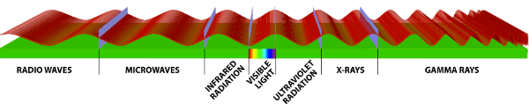
All seven types of EMR are useful forms of energy and have various applications.
These applications depend on their wavelength, frequency and energy level.

Slide 7
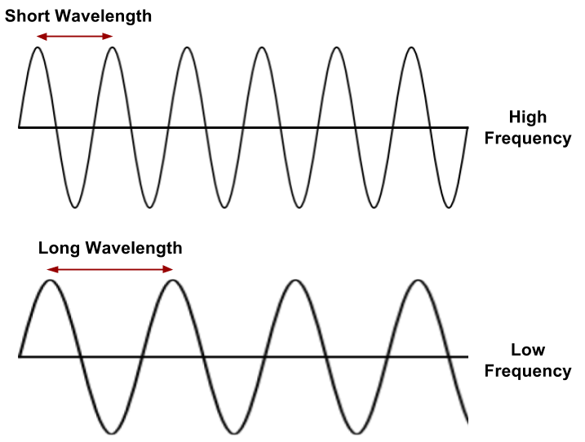
A wavelength is the distance between two peaks or two troughs. A wave consists of many wavelengths.
Frequency is the number of peaks that pass a certain point in one second.
As wavelength decreases, frequency increases. As wavelength increases, frequency decreases.

Slide 8
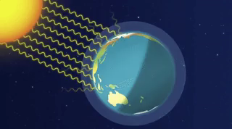
Now that we know how the seven types of electromagnetic radiation differ, let's have a look at the properties and different applications of each form of radiation.

Slide 9
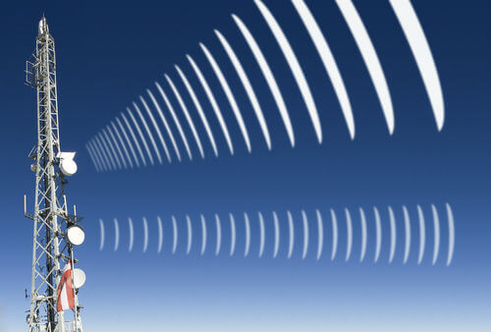
Radio waves have the longest wavelengths (1 mm - 100 km), the lowest frequency and the least energy of all the forms of EMR.
These properties allow radio waves to travel extremely long distances, which is why they are used for communications. Radio waves are particularly useful for transmitting television and radio signals.

Slide 10

Microwaves come next on the spectrum, falling between radio waves and infrared.
Microwaves have long wavelengths (1 mm to 10 cm), low frequency and low energy.
These properties makes microwaves perfect for transmitting information over long distances.

Slide 11
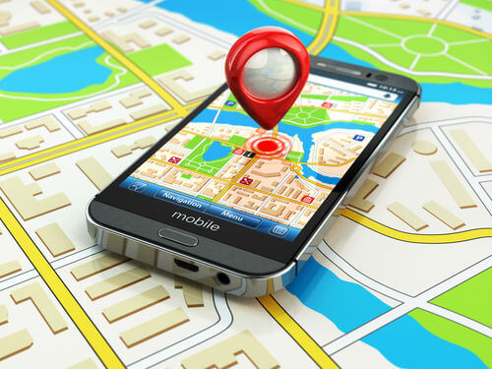
Some microwave wavelengths are able to pass through the Earth's atmosphere, which means they can transmit information to and from satellites.
This is how global positioning system (GPS) devices track locations.
Microwaves are also used to transmit mobile phone, bluetooth and Wi-Fi signals, and to heat food in microwave ovens.

Slide 12
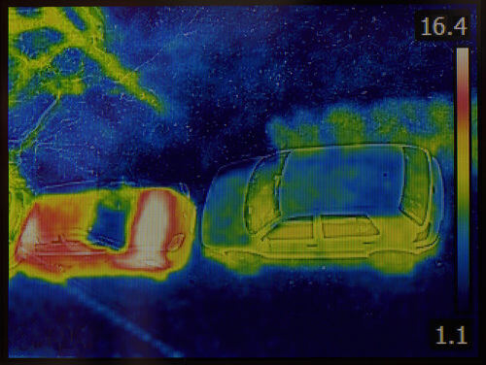
Infrared falls along the electromagnetic spectrum between microwaves and visible light.
Infrared has longer wavelengths (700 nm−1 mm), lower frequencies and lower energy than visible light.
Infrared rays travel through the atmosphere and their energy is felt as heat.

Slide 13
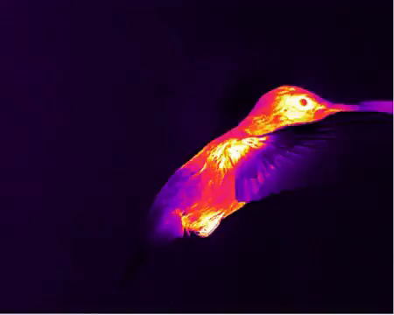
Infrared sensors are able to detect heat from the body and they also are used in security lights, burglar alarms and disease detection.
Infrared radiation is also able to transmit information from place to place. It is used in television remote controls and to transmit information over short distances between computers or mobile phones.
Earth is kept at a comfortable living temperature thanks to infrared radiation. The greenhouse effect traps infrared radiation in the atmosphere, which stabilises the temperature on Earth.

Slide 14
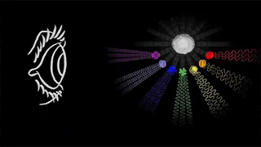
Visible light makes up only a small section of the EMR spectrum.
It includes all wavelengths between 400 and 700 nm.
Colours are produced by light waves of different frequencies and wavelengths. White light is a combination of the entire colour spectrum. Objects around us are coloured differently depending on the wavelengths that they absorb and reflect.
Red has the longest wavelength and the lowest frequency of all the colours. Violet has the shortest wavelength and the highest frequency of all the colours.

Slide 15

Ultraviolet radiation, also known as UV, falls along the electromagnetic spectrum between visible light and x-rays.
It is produced by very hot objects like the Sun or solariums. UV has short wavelengths, ranging between 10−400 nm, high frequencies and high energy.
UV travels through the atmosphere along with infrared radiation (felt as heat) and visible light (what we can see), although only a small amount of UV actually reaches Earth's surface.

Slide 16
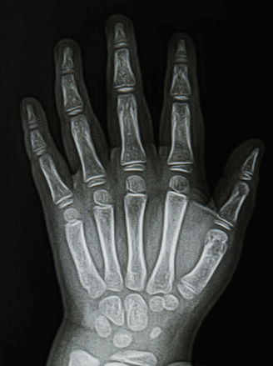
X-rays come next on the EMR spectrum, sitting between UV and gamma rays.
X-rays have a short wavelength, ranging from 0.01 to 10 nm. They also have a high frequency and high energy level.
The density of the medium determines how many x-rays can pass through it.

Slide 17

X-rays are commonly used for medical imaging because they can pass through low density tissue, like muscle, but are absorbed or scattered by high density tissue, like bone.
Security scanning uses x-rays to determine the contents of luggage and other packaged goods. They are also used to explore space, since astronomical objects that contain extremely hot gasses emit x-rays.

Slide 18
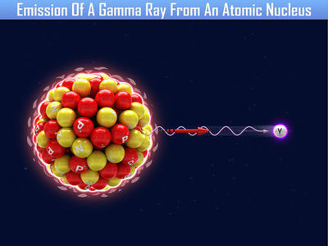
Gamma rays have the shortest wavelengths (< 0.01 nm), the highest frequency and the most energy of all the forms of EMR.
They are able to travel through most media and are difficult to stop.

Slide 19
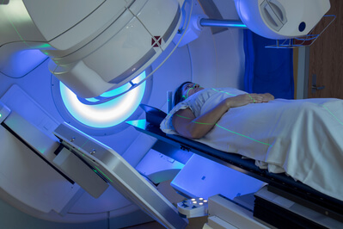
The properties of gamma rays allow them to easily pass through the human body, making them particularly useful for detecting and treating cancer.
Gamma rays are also used to sterilise equipment and surfaces in different industries.

